Slide 2
XPath
In this first lesson, XPath, you will learn to:
  Define and describe XPath.
  Identify nodes according to XPath.
  List operators used with XPath.
  Describe the types of matching.
2

Slide 3
Introduction to XPath 1-3
Can be thought of as a query language like SQL.
Rather than extracting information from a database, it extracts information from an XML document.
Is a language for retrieving information from a XML document.
Is used to navigate through elements and attributes in an XML document.
Allows identifying parts of an XML document.

Slide 4
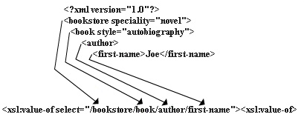
Introduction to XPath 2-3
XPath provides a common syntax as shown in figure for features shared by XSLT and XQuery.
  XSLT
    XSLT is a language for transforming XML documents into XML, HTML, or text.
  XQuery
    XQuery builds on XPath and is a language for extracting information from XML documents.

Slide 5
Introduction to XPath 3-3
XPath is designed for XML documents.
It provides a single syntax that you can use for queries, addressing, and patterns.
XPath is concise, simple, and powerful.

Slide 6
Benefits of XPath
Syntax is simple for the simple and common cases.
Any path that can occur in an XML document and any set of conditions for the nodes in the path can be specified.
Any node in an XML document can be uniquely identified.
XPath is designed to be used in many contexts such as providing links to nodes, for searching repositories, and for many other applications.

Slide 7
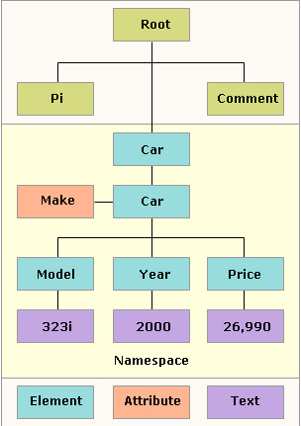
XML Document in XPath 1-5
In XPath, an XML document is viewed conceptually as a tree in which each part of the document is represented as a node as shown in the figure.

Slide 8
XML Document in XPath 2-5
XPath documents have seven types of nodes:
  Root
    The XPath tree has a single root node, which contains all other nodes in the tree.
  Element
    Every element in a document has a corresponding element node that appears in the tree under the root node.
    Within an element node appear all of the other types of nodes that correspond to the elements content.
    Element nodes may have a unique identifier associated with them that is used to reference the node with XPath.
  Attribute
    Each element node has an associated set of attribute nodes; the element is the parent of each of these attribute nodes; however, an attribute node is not a child of its parent element.
  Text
    Character data is grouped into text nodes.
    Characters inside comments, processing instructions and attribute values do not produce text nodes.
    The text node has a parent node and it may be the child node too.

Slide 9
XML Document in XPath 3-5
  Comment
    There is a comment node for every comment, except for any comment that occurs within the document type declaration.
    The comment node has a parent node and it may be the child node too.
  Processing instruction
    There is a processing instruction node for every processing instruction, except for any processing instruction that occurs within the document type declaration.
    The processing instruction node has a parent node and it may be the child node too.
  Namespace
    Each element has an associated set of namespace nodes.
    Although the namespace node has a parent node, the namespace node is not considered a child of its parent node because they are not contained in a parent node, but are used to provide descriptive information about their parent node.

Slide 10
XML Document in XPath 4-5
The table shows a summary of different types of nodes in XPath.
Node Type | String Value | Expanded Name | Description
root | Determined by concatenating the string-values of all text-node descendents in document order. | None. | Represents the root of an XML document. This node exists only at the top of the tree and may contain element, comment or processor-instruction children.
element | Determined by concatenating the string-values of all text-node descendents in document order. | The element tag, including the namespace prefix (if applicable). | Represents an XML document which may contain element, text, comment or processor-instruction children.
attribute | The normalized value of the attribute. | The name of the attribute, including the namespace prefix (if applicable). | Represents an attribute of an element.

Slide 11
XML Document in XPath 5-5
The table shows additional types of nodes in XPath.
Node Type | String Value | Expanded Name | Description
text | The character data contained in the text node. | None. | Represents the character data content of an element.
comment | The content of the comment (not including <!-- and -->). | None. | Represents an XML comment.
processing instruction | The part of the processing instruction that follows the target and any whitespace. | The target of the processing instruction. | Represents an XML processing instruction.
namespace | The URI of the namespace. | The namespace prefix. | Represents an XML namespace.

Slide 12
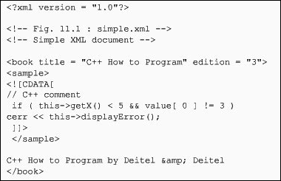
XPath Representation 1-2
An XPath query operates on a well-formed XML document after it has been parsed into a tree structure.
The following figure depicts a simple XML document along with its generated XPath tree.

Slide 13
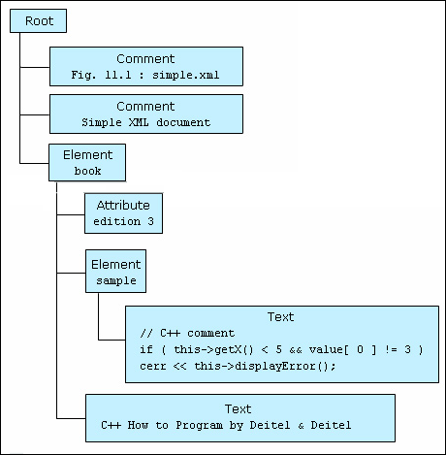
XPath Representation 2-2
The corresponding XPath tree that is generated is shown:

Slide 14
Operators in XPath
An XPath expression returns a node set, a boolean, a string, or a number.
XPath provides basic floating point arithmetic operators and some comparison and boolean operators.
The XPath expressions are constructed using the operators and special characters as shown in the table.
Operator | Description
/ | Child operator; selects immediate children of the left-side collection.
// | Recursive descent; searches for the specified element at any depth.
. | Indicates the current context.
.. | The parent of the current context node.

Slide 15
Examples of XPath Operators 1-3
The table shows a few examples along with their description that use XPath operators in an expression.
Expression | Refers to
Author/FirstName | All <FirstName> elements within an <Author> element of the current context node.
BookStore//Title | All <Title> elements one or more levels deep in the <BookStore> element.
BookStore/*/Title | All <Title> elements that are grandchildren of <BookStore> elements.
BookStore//Book/Excerpt//Work | All <Work> elements anywhere inside <Excerpt> children of <Book> elements, anywhere inside the <BookStore> element.

Slide 16
Examples of XPath Operators 2-3
A list of the operators that can be used in XPath expressions is given in the table.
Operator | Description | Example | Return value
| | Computes two node-sets | //book | //cd | Returns a node-set with all book and cd elements.
+ | Addition | 36+14 | 50
- | Subtraction | 36-14 | 22
* | Multiplication | 6*4 | 24
div | Division | 28 div 14 | 2
= | Equal | price=9.50 | true, if price is 9.50 false, if price is 9.60
!= | Not Equal | price!=9.50 | true, if price is 9.90 false, if price is 9.50
< | less than | price<9.50 | true, if price is 9.00 false, if price is 9.50
<= | less than or equal to | price<=9.50 | true, if price is 9.00 false, if price is 9.60

Slide 17
Examples of XPath Operators 3-3
Few more operators that can be used in XPath expressions are given in the table.
Operator | Description | Example | Return value
> | greater than | price>9.50 | true, if price is 9.60 false, if price is 9.50
>= | greater than or equal to | price>=9.50 | true, if price is 9.60 false, if price is 9.40
or | or | price=9.50 or price=9.90 | true, if price is 9.90 false, if price is 9.40
and | and | price=9.50 and price=9.90 | true, if price is 9.70 false, if price is 8.70
mod | Modulus(division remainder) | 15 mod 4 | 3

Slide 18
Types of Matching 1-4
XPath is used in the creation of the patterns.
The match attribute of the xsl:template element supports a complex syntax that allows to express exactly which nodes to be matched.
The select attribute of xsl:apply-templates, xsl:value-of, xsl:for-each, xsl:copy-of, and xsl:sort supports an even more powerful superset of this syntax that allows to express exactly which nodes to selected and which nodes not to be selected.

Slide 19
Types of Matching 2-4
Some important types of matching are:
  Matching by name
    The source element is simply identified by its name, using the match attribute. The value given to the match attribute is called the pattern. The code demonstrates the example.
  matches all greeting elements in the source document.
Snippet
<xsl:template match = "Greeting">
  Matching by ancestry
    As in CSS, a match can be made using the elements ancestry. The following tag will match any 'EM' element that has 'P' as an ancestor.
Snippet
<xsl:template match = "P//EM">

Slide 20
Types of Matching 3-4
  Matching the element names
    The most basic pattern contains a single element name which matches all elements with that name. The code demonstrates the example. This template matches Product elements and marks their Product_ID children bold.
Snippet
<xsl:template match="Product">
<xsl:value-of select="Product_ID"/>
</xsl:template>
  Matching the root
    To enable all the descendant nodes to inherit the properties on the root of document, use a single forward slash to represent the root. The code demonstrates the example.
    This will select the root pattern.
Snippet
<xsl:template match = "/">

Slide 21
Types of Matching 4-4
  Matching by attribute
    The syntax used to match the attribute is:
    This syntax uses square brackets to hold the attribute name and value.
    The code demonstrates the example.
    The given example applies the templates to the non-existent Units attributes of Product elements.
Syntax
<xsl:template match = " element name['attribute' (attribute-name)=attribute-value]">
Snippet
<xsl:template match="Product">
<xsl:apply-templates select="@Units"/>
</xsl:template>

Slide 22
XPath Expressions and Functions
In this second lesson, XPath Expressions and Functions, you will learn to:
  State and explain the various XPath expressions and functions.
  List the node set functions.
  List the boolean functions.
  State the numeric functions.
  Describe the string functions.
  Explain what result tree fragments are.

Slide 23
XPath Expressions 1-2
XPath expressions are statements that can extract useful information from the XPath tree.
Instead of just finding nodes, one can count them, add up numeric values, compare strings, and more.
They are much like statements in a functional programming language.
Every XPath expression evaluates to a single value.

Slide 24
XPath Expressions 2-2
There are four types of expressions in XPath. They are:
  Node-set
    A node-set is an unordered group of nodes from the input document that match an expressions criteria.
  Boolean
    A boolean has one of two values: true or false. XSLT allows any kind of data to be transformed into a boolean. This is often done implicitly when a string or a number or a node-set is used where a boolean is expected.
  Number
    XPath numbers are numeric values useful for counting nodes and performing simple arithmetic. The numbers like 43 or –7000 that look like integers are stored as doubles. Non-number values, such as strings and booleans, are converted to numbers automatically as necessary.
  String
    A String is a sequence of zero or more Unicode characters. Other data types can be converted to strings using the string() function.

Slide 25
XPath Functions
XPath defines various functions required for XPath 2.0, XQuery 1.0, and XSLT 2.0.
The different functions are Accessor, AnyURI, Node, Error and Trace, Sequence, Context, Boolean, Duration/Date/Time, String, Qname, and Numeric.
XML Path Language (XPath) functions can be used to refine XPath queries, and enhance the programming power and flexibility of XPath.
Each function in the function library is specified using a function prototype that provides the return type, function name, and argument type.
If an argument type is followed by a question mark, the argument is optional; otherwise, the argument is required. Function names are case-sensitive.
The default prefix for the function namespace is fn.

Slide 26
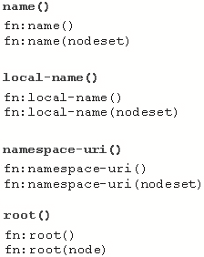
Node-set Functions 1-6
Node-set functions take a node-set argument.
These return a node-set, or information about a particular node within a node-set.
The different node-set functions are name(), local-name(),
namespace-uri(), and root().
The figure shows the syntax for
node-set functions.

Slide 27
Node-set Functions 2-6
In the syntax,
    name():
      The function returns the name of the current node or the first node in the specified node-set.
    local-name():
      The function returns the name of the current node or the first node in the specified node-set without the namespace prefix.
    namespace-uri():
      The function returns the namespace URI of the current node or the first node in the specified node-set.
    root():
      The function returns the root of the tree to which the current node or the specified node belongs. This will usually be a document node.

Slide 28
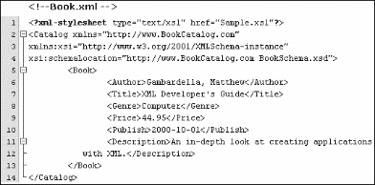
Node-set Functions 3-6
The following figure shows the code.

Slide 29
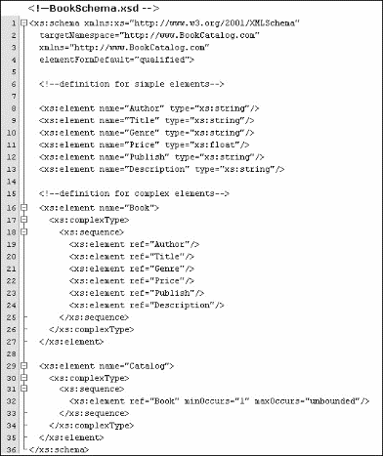
Node-set Functions 4-6
The following figure shows the schema.

Slide 30
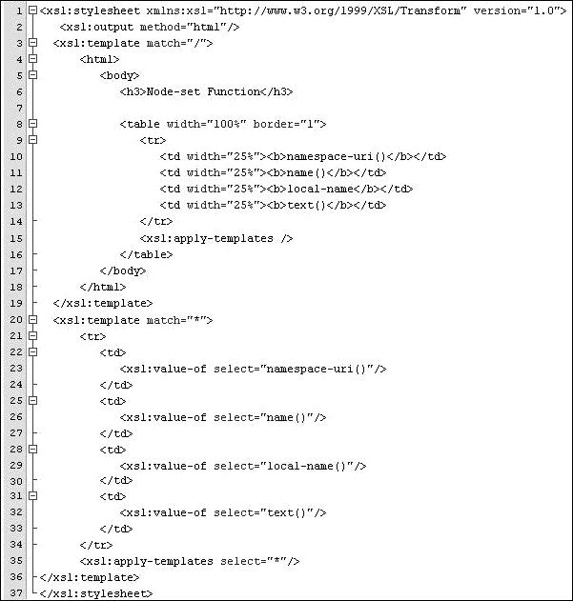
Node-set Functions 5-6
The figure depicts the style sheet.

Slide 31
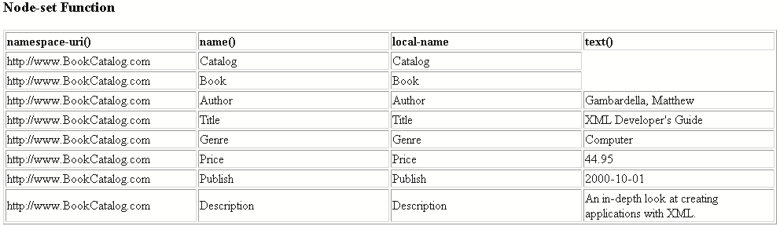
Node-set Functions 6-6
The formatted output is displayed as follows:

Slide 32
Boolean Functions 1-7
The XML Path Language (XPath) syntax supports boolean functions that return true or false and can be used with comparison operators in filter patterns.
Some of these functions are boolean, not, true, and false.
  boolean(arg)
    The function returns a boolean value for a number, string, or node-set.
Syntax
fn:boolean(arg)

Slide 33
Boolean Functions 2-7
Snippet
<ul>
<li><b>boolean(0)</b> = <xsl:value-of select="boolean(0)"/>
</li>
<li><b>boolean(1)</b> = <xsl:value-of select="boolean(1)"/>
</li>
<li><b>boolean(-100)</b> = <xsl:value-of select="boolean(-100)"/>
</li>
<li><b>boolean('hello')</b> = <xsl:value-of select="boolean('hello')"/>
</li>
<li><b>boolean('')</b> = <xsl:value-of select="boolean('')"/>
</li>
<li><b>boolean(//book)</b> = <xsl:value-of select="boolean(//book)"/>
</li>
</ul>
Output:
boolean(0) = false
boolean(1) = true
boolean(-100) = true
boolean('hello') = true
boolean('') = false
boolean(//book) = false

Slide 34
Boolean Functions 3-7
  not(arg)
    The sense of an operation can be reversed by using the not() function.
    This template rule selects all Product elements that are not the first child of their parents.
    The same template rule could be written using the not equal operator != instead.
Syntax
fn:not(arg)
Snippet
<xsl:template match="PRODUCT[not(position()=1)]">
<xsl:value-of select="."/>
</xsl:template>
Snippet
<xsl:template match="PRODUCT[position()!=1]">
<xsl:value-of select="."/>
</xsl:template>

Slide 35
Boolean Functions 4-7
  true()
    The true() function returns the boolean value true.
  false()
    The false() function returns the boolean value false.
Syntax
fn:true()
Snippet
<xsl:value-of select="true()"/>
    Output:
    true
Syntax
fn:false()
Snippet
Output:
true
false
false
<xsl:value-of select="false() or false()"/>
<xsl:value-of select="true() and false()"/>
<xsl:value-of select="false() and false()"/>

Slide 36
Boolean Functions 5-7
The value derived from an expression depends on some Boolean conversion rules as shown in the table.
Expression Type | Rule
Node-set | True if the set contains at least one node, false if it is empty.
String | True unless the string is zero-length.
Number | True unless the value is zero or NaN (not a number).
Result tree fragment | Always true, because every fragment contains at least one node, its root node.

Slide 37
Boolean Functions 6-7
Certain operators compare numerical values to arrive at a Boolean value. All the nodes in a node-set are tested to determine whether any of them satisfies the comparison or not. Comparison operators are shown in the table.
Operator | Returns
expr = expr | True if both expressions (string or numeric) have the same value, otherwise false.
expr != expr | True if the expressions do not have the same value (string or numeric), otherwise false.
expr < expr | True if the value of the first numeric expression is less than the value of the second, otherwise false.
expr > expr | True if the value of the first numeric expression is greater than the value of the second, otherwise false.
expr <= expr | True if the value of the first numeric expression is less than or equal to the value of the second, otherwise false.
expr >= expr | True if the value of the first numeric expression is greater than or equal to the value of the second, otherwise false.

Slide 38
Boolean Functions 7-7
The different functions that return Boolean values are shown in the table.
Function | Returns
expr and expr | True if both Boolean expressions are true, otherwise false.
expr or expr | True if at least one Boolean expression is true, otherwise false.
true() | True.
false() | False.
not(expr) | Negates the value of the Boolean expression: true if the expression is false, otherwise false.

Slide 39
Numeric Functions 1-8
XPath syntax supports number functions that return strings or numbers and can be used with comparison operators in filter patterns.
The different numeric functions are number(arg), ceiling(num), floor(num), and round(num).
The rules for converting any expression into a numeric value are listed in the table.
Expression Type | Rule
Node-set | The first node is converted into a string, then the string conversion rule is used.
Boolean | The value true is converted to the number 1, and false to the number 0.
String | If the string is the literal serialization of a number (that is, -123.5), it is converted into that number. Otherwise, the value NaN is used.
Result-tree fragment | Like node-sets, a result-tree fragment is converted into a string, which is then converted with the string rule.

Slide 40
Numeric Functions 2-8
To manipulate numeric values, there are a variety of operators and functions as shown in the table.
Function | Returns
expr + expr | The sum of two numeric expressions.
expr - expr | The difference of the first numeric expression minus the second.
expr * expr | The product of two numeric expressions.
expr div expr | The first numeric expression divided by the second expression.
expr mod expr | The first numeric expression modulo the second expression.
round(expr) | The value of the expression rounded to the nearest integer.
sum(node-set) | The sum of the values of the nodes in node-set. Unlike the other functions in this table, this function operates over a node-set instead of expressions.

Slide 41
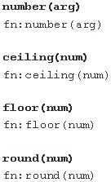
Numeric Functions 3-8
The figure shows the syntax for numeric functions.

Slide 42
Numeric Functions 4-8
In the syntax,
  number(arg)
    The function returns the numeric value of the argument. The argument could be a boolean, a string, or a node-set.
  ceiling(num)
    The function returns the smallest integer that is greater than the number argument.
  floor(num)
    The function returns the largest integer that is not greater than the number argument.
  round(num)
    The function rounds the number argument to the nearest integer.

Slide 43
Numeric Functions 5-8
The code depicts the style sheet for numeric functions.
Snippet
<?xml version="1.0"?>
<?xml-stylesheet type="text/xsl" href="Number.xsl"?>
<xsl:stylesheet version="1.0"
xmlns:xsl="http://www.w3.org/1999/XSL/Transform">
<xsl:output method="html"/>
<xsl:template match="/">
<html>
<body>
<h3>Numeric Functions</h3>
<ul>
<li>
<b>number('1548')</b> =
<xsl:value-of select="number('1548')"/>
</li>
<li>
<b>number('-1548')</b> =
<xsl:value-of select="number('-1548')"/>
</li>
<li>
<b>number('text')</b> =
<xsl:value-of select="number('text')"/>
</li>

Slide 44
Numeric Functions 6-8
<li>
<b>number('226.38' div '1')</b>
=
<xsl:value-of select="number('226.38' div '1')"/>
</li>
</ul>
<ul>
<li>
<b>ceiling(2.5)</b>
=
<xsl:value-of select="ceiling(2.5)"/>
</li>
<b>ceiling(-2.3)</b> =
<xsl:value-of select="ceiling(-2.3)"/>
</li>
<li>
<b>ceiling(4)</b> =
<xsl:value-of select="ceiling(4)"/>
</li>
</ul>
<ul>
<li>
<b>floor(2.5)</b> =
<xsl:value-of select="floor(2.5)"/>

Slide 45
Numeric Functions 7-8
</li>
<li>
<b>floor(-2.3)</b>
=
<xsl:value-of select="floor(-2.3)"/>
</li>
<li>
<b>floor(4)</b>
=
<xsl:value-of select="floor(4)"/>
</li>
</ul>
<ul>
<li>
<b>round(3.6)</b>
=
<xsl:value-of select="round(3.6)"/>
</li>
<li>
<b>round(3.4)</b>
=
<xsl:value-of select="round(3.4)"/>

Slide 46
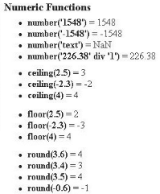
Numeric Functions 8-8
</li>
<li>
<b>round(3.5)</b>
=
<xsl:value-of select="round(3.5)"/>
</li>
<li>
<b>round(-0.6)</b>
=
<xsl:value-of select="round(-0.6)"/>
</li>
<li>
<b>round(-2.5)</b>
=
<xsl:value-of select="round(-2.5)"/>
</li>
</ul>
</body>
</html>
</xsl:template>
</xsl:stylesheet>
Output:

Slide 47
String Functions 1-6
String functions are used to evaluate, format, and manipulate string arguments, or to convert an object to a string. The different String functions are shown in the table.
Function | Returns
concat(string, string, . . .) | A string that is the concatenation of the string arguments.
format-number(number, pattern, decimal-format) | A string containing the number, formatted according to pattern. The optional decimal-format argument points to a format declaration which assigns special characters like the grouping character, which separates groups of digits in large numbers for readability.
normalize-space(string) | The string with leading and trailing whitespace removed, and all other strings of whitespace characters replaced with single spaces.
substring(string, offset, range) | A substring of the string argument, starting offset characters from the beginning and ending range characters from the offset.
substring-after(string, to-match) | A substring of the string argument, starting at the end of the first occurrence of the string to-match and ending at the end of string.
substring-before(string, to-match) | A substring of the string argument, starting at the beginning of string and ending at the beginning of the first occurrence of the string to-match.
translate(string, characters-to-match, characters-replace-with) | The string with all characters in the string characters-to-match replaced with their counterpart characters in the string characters-replace-with.

Slide 48
String Functions 2-6
Some functions that operate on strings and return numeric or Boolean values are listed in the table.
Function | Returns
contains(string, sub) | True if the given substring sub occurs within the string, otherwise false.
starts-with(string, sub) | True if the string begins with the substring sub, otherwise false.
string-length(string) | The number of characters inside the string.

Slide 49
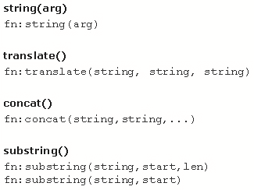
String Functions 3-6
Figure 7.11 shows the syntax for string functions.
where,
  string(arg)
    The function returns the string value of the argument. The argument could be a number, boolean, or node-set. For example: string(314) returns "314".
  translate()
    The function returns the first argument string with occurrences of characters in the second argument string replaced by the character at the corresponding position in the third argument string. For example: translate("bar","abc","ABC") returns Bar.
  concat()
    The function returns the concatenation of the strings. For example: concat('XPath','is ','FUN!') returns 'XPath is FUN!'.
  substring()
    The function returns the substring from the start position to the specified length. Index of the first character is 1. For example: substring('Beatles',1,4) returns 'Beat’.
The figure shows the syntax for string functions.

Slide 50
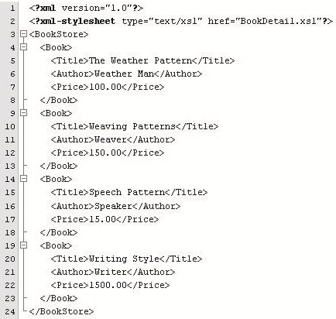
String Functions 4-6
The figure shows the code in an XML file.

Slide 51
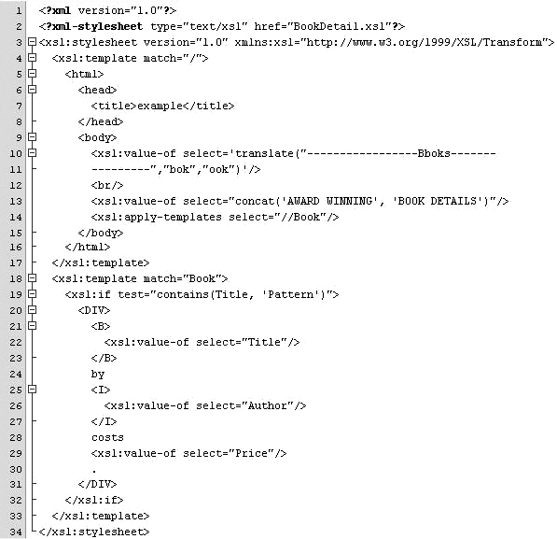
String Functions 5-6
The figure depicts the style sheet for bookdetail.xsl file.

Slide 52

String Functions 6-6
The output is shown in the following figure:

Slide 53
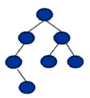
Result Tree Fragments
A Result tree fragment is a portion of an XML document that is not a complete node or set of nodes.
The only allowed operation in a result tree fragment is on a string.
The operation on the string may involve first converting the string to a number or a boolean.
Result tree fragment is an additional data type other than four basic XPath data types (such as, string, number, boolean, node-set).
A result tree fragment represents a fragment of the result tree. In particular, it is not permitted to use the /, //, and [] XPath operators on Result tree fragments.

Slide 54
Working with Different Styles
In this last lesson, Working with Different Styles, you will learn to:
  Explain how to switch between styles.
  Describe how to transform XML documents into HTML using XSLT.

Slide 55
Transformation of XML Documents 1-2
Transformation is one of the most important and useful techniques for working with XML.
XML can be transformed by changing its structure, its markup, and perhaps its content into another form.
The most common reason to transform XML is to extend the reach of a document into new areas by converting it into a presentational format.
XML Documents
Transformed Result
Transformation Engine

Slide 56
Transformation of XML Documents 2-2
Some uses of transformation are:
  Formatting a document to create a high-quality presentational format.
  Changing one XML vocabulary to another.
  Extracting specific pieces of information and formatting them in another way.
  Changing an instance of XML into text.
  Reformatting or generating content.

Slide 57
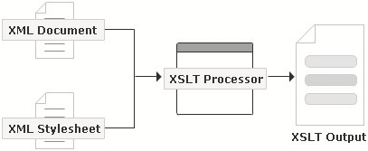
Transformation using XSLT Processor
The transformation process:
  An XSLT processor takes two things as input: an XSLT style sheet to govern the transformation process and an input document called the source tree.
  The output is called the result tree.
  The XSLT engine begins by reading in the XSLT style sheet and caching it as a
  look-up table.
  XPath locates the parts of XML document such as Element nodes, Attribute nodes, and Text nodes.
  Thus, for each node the XSLT processes, it will look in the table for the best matching rule to apply.
  Starting from the root node, the XSLT engine finds rules, executes them, and continues until there are no more nodes in its context node set to work with.
  At that point, processing is complete and the XSLT engine outputs the result document.

Slide 58
Transforming XML using XSLT 1-2
The transformation of XML documents can be done in various steps:
  Step 1
  Start by creating a normal XML document.
    <?xml version="1.0" encoding="UTF-8"?>
  Step 2
  Then add the lines shown to create an XSL style sheet.
  Step 3
  Now, set it up to produce HTML-compatible output.
Snippet
<?xml version="1.0" encoding="ISO-8859-1"?>
<xsl:stylesheet xmlns:xsl="http://www.w3.org/1999/XSL/Transform"
version="1.0" >
...
</xsl:stylesheet>
Snippet
<xsl:stylesheet>
<xsl:output method="html"/>
...
</xsl:stylesheet>

Slide 59
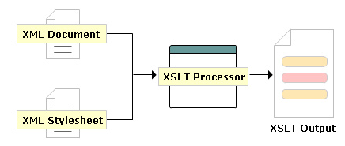
Transforming XML using XSLT 2-2
To output anything besides well-formed XML, an <xsl:output> tag should be used like the one shown, specifying either "text" or "html". (The default value is "xml".)

Slide 60
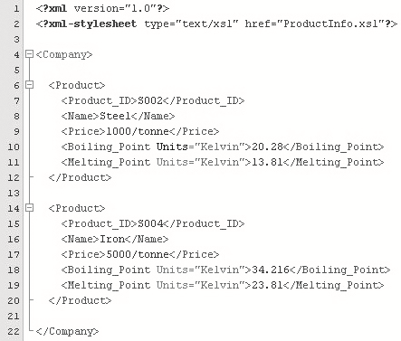
Transforming XML using XSLT Example 1-2
An example code of transforming XML documents into HTML using XSLT processor has been provided to explain the process.
In the code:
  Company: The root Company element contains Product child elements.
  Units: A Units attribute specifies the units for the respective products melting point and boiling point.

Slide 61
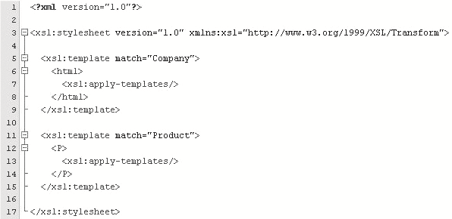

Transforming XML using XSLT Example 2-2
ProductInfo.xsl:
The output displays the transformed HTML from the XML document in the browser.
Output:

Slide 62
Module Summary
In this module, More on XSLT, you learnt about:
  XPath
    XPath is a notation for retrieving information from a document. XPath provides a common syntax for features shared by Extensible Style sheet Language Transformations (XSLT), and XQuery. XPath have seven types of node as Root, Element, Attribute, Text, Comment, Processing instruction, and Namespace. XPath is used in the creation of the patterns.
  XPath Expressions and Functions
    The four types of expressions in XPath are Node-sets, Booleans, Numbers, and Strings. The different functions defined for XPath are Accessor, AnyURI, Node, Error and Trace, Sequence, Context, Boolean, Duration/Date/Time, String, Qname, and Numeric. A Result tree fragment is a portion of an XML document that is not a complete node or set of nodes.
  Working with Different Styles
    Transformation is one of the most important and useful techniques for working with XML. To transform XML is to change its structure, its markup, and perhaps its content into another form. Transformation can be carried out using an XSLT processor also.

